Slide 1


<Name: AMULYA>
<Date: 23-07-2023>

Slide 2

Outline
Executive Summary
Introduction
Methodology
Results
Conclusion
Appendix

Slide 3
Executive Summary
Summary of methodologies
Data collection and wrangling
EDA and interactive visual analytics
EDA with SQL results
Interactive map with folium
Plotly Dash dashboard
Predictive analysis
Summary of all results
Which factors are most effecting the successfully land payload
Best model for predicting the target variable

Slide 4
Introduction
Project background and context
we will predict if the Falcon 9 first stage will land successfully. SpaceX advertises Falcon 9 rocket launches on its website with a cost of 62 million dollars; other providers cost upward of 165 million dollars each, much of the savings is because SpaceX can reuse the first stage. Therefore, if we can determine if the first stage will land, we can determine the cost of a launch.
Problems you want to find answers
Which factors are affecting the SpaceX land successfully
Which model is best for predicting the SpaceX landing
To find the relation between features and target variable

Slide 5

Section 1

Slide 6
Methodology
Executive Summary
Data collection methodology:
Request to the SpaceX API
Web scraping from Wikipedia
Perform data wrangling
Performing one hot encoding on categorical column and determining the best labels for machine learning algorithm
Perform exploratory data analysis (EDA) using visualization and SQL
Creating scatter and bar graphs to find the relation between the variables
Perform interactive visual analytics using Folium and Plotly Dash
By using folium find locations of launching site and creating dashboard for analyzing.
Perform predictive analysis using classification models
Build and evaluate classification model

Slide 7
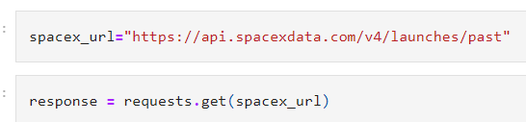
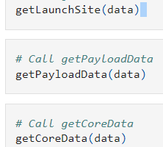
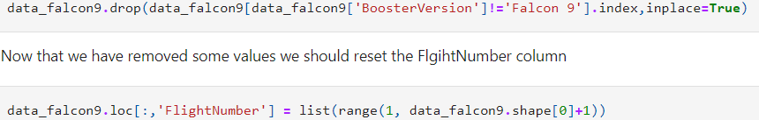

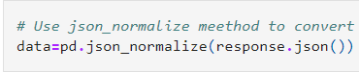
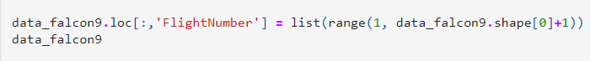
Data Collection
Apply custome functions to clean data
Assign list to dictionary then create dataframe
Filter dataframe and export to flat file
Getting response from API
Converting response to a .json file

Slide 8
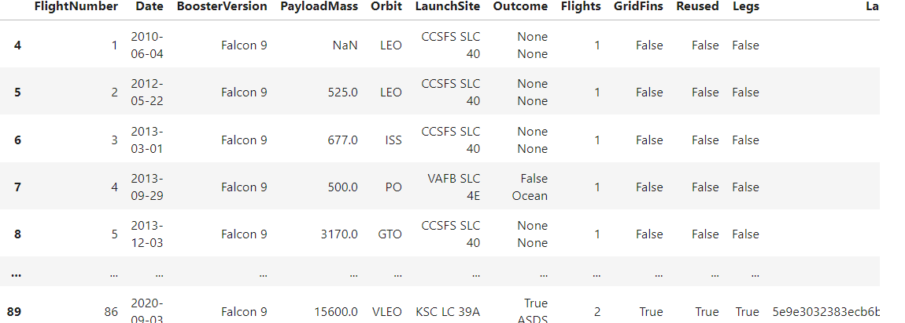
Data Collection – SpaceX API
GitHub

Slide 9
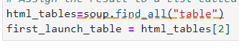
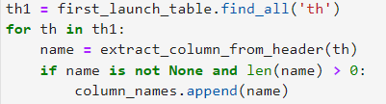
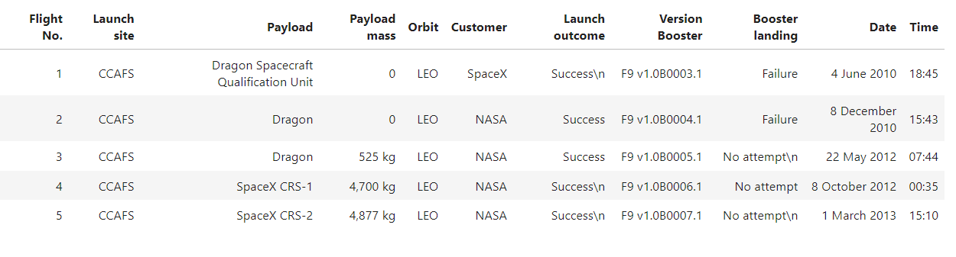
Data Collection – Scraping Github
nfr
Getting response from HTML
Creating Beautifulsoup Object
Finding tables
Getting column names
Creation of dictionary and appending data to keys
Convering dictionary to dataframe

Slide 10
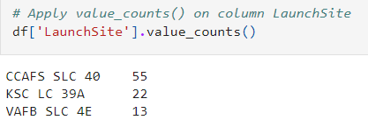
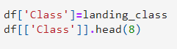
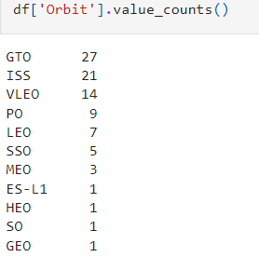
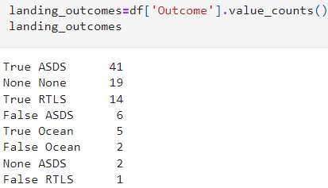
Data Wrangling
Calculate number and occurrence of mission outcome per orbit type
Create landing outcome label from outcome column
Export dataset as.CSV
Calculate number of launches at each site
Calculate number and occurrence of each orbit

Slide 11
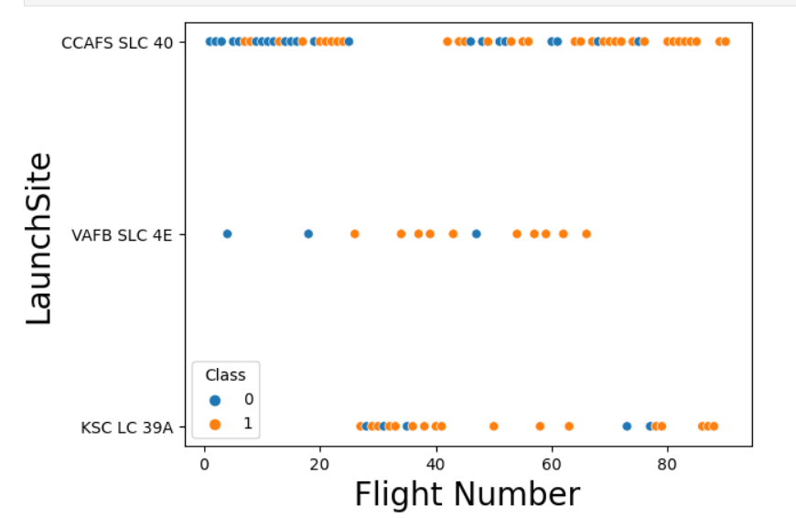
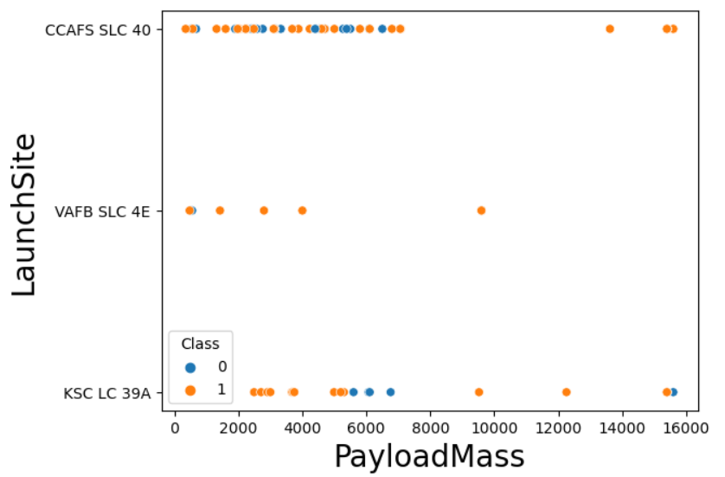
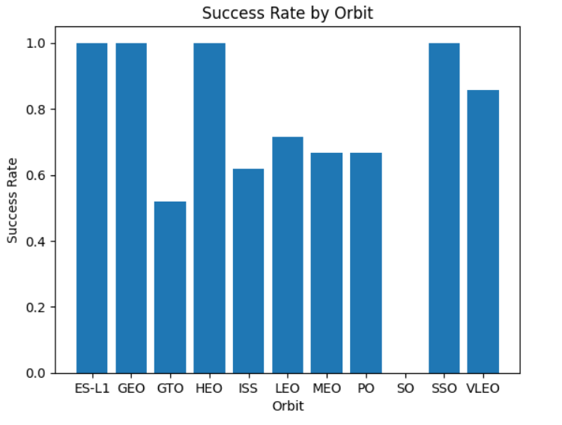
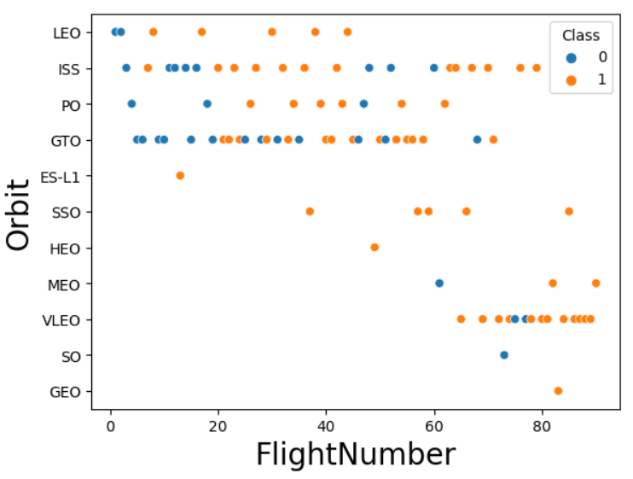
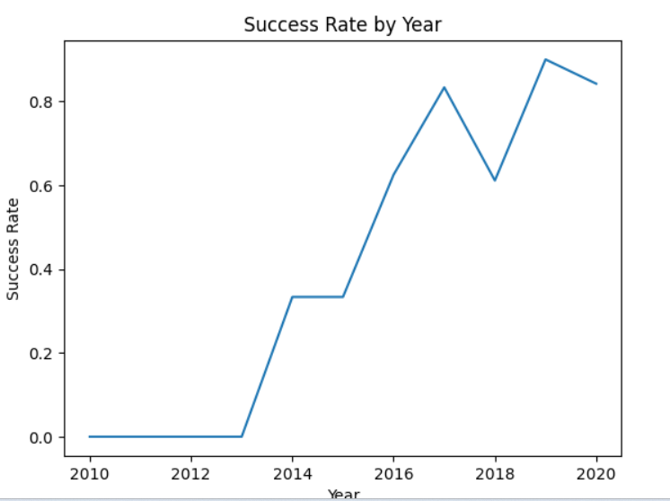
EDA with Data Visualization
Scatter plots
Bar plots
Line plot

Slide 12
EDA WITH SQL
SQL (Structured Query Language) is used to perform operations on the records stored in the database, such as updating records, inserting records, deleting records, creating and modifying database tables, views, etc.
We performed SQL queries to gather information from given dataset:
Displaying the names of the unique launch sites in the space mission
Display 5 records where launch sites begin with the string ‘CCA’
Displaying the total payload mass carried by boosters launched by NASA(CRS)
Displaying average payload mass carries by booster version F9v1.1
Listing the date where the successful landing outcome in drone ship was achieved
Listing the names of the boosters which have success in ground pad and have payload mass greater than 4000 but less than 6000
Listing the total number of successful and failure mission outcomes
Listing the names of the booster versions which have carries the maximum payload mass
Listing the failed landing outcomes in drone ship, there booster versions, and launch site names for the year 2015
Ranking the count of landing outcomes (such as Failure or Success)between the date 2010-06-04 and 2017-03-20, in descending order

Slide 13

Map objects | Code | Result
Map Marker | folium.Marker( | Map object to make a mark on map
Icon marker | folium.Icon( | Create an icon on map
Circle marker | folium.Circle( | Create a circle where marker is being placed
PolyLine | folium.PloyLine( | Create a line between points.
Marker cluster object | MarkerCluster() | This is a good way to simplify a map containing many markers having the same coordinate.
AntPath | Folium.plugins.AntPath( | Create an animated line between points
Build an Interactive Map with Folium

Slide 14
Build a Dashboard with Plotly Dash
Map objects | Code | Results
Dash and it’s components | import dash | Plotly steward's python leading data viz and viz and UI libraries.
Pandas | Import pandas as pd | Fetcching values from CSV and creating a dataframe
Plotly | Import plotly.express as px | Plot the graphs with interactive plotly library
Dropdown | dcc.Dropdown( | Create a dropdown for launche sites
Rangeslider | dcc.Rangeslider( | Create a rangeslider for payload Mass range selection
Pie chart | Px.pie( | Creating the pie graph for success percentage display
Scatter Chart | Px.scatter( | Creating the scatter graph for correlation display
Pie chart showing the total success for all sites or by certain launch site
percentage of success in relation to launch site
Scatter Graph showing the correlation between Payload and Success for all sites by certain launch site
It shows the relationship between Success rate and Booster Version Category.

Slide 15

Predictive analysis(classification)
Building model
Load our feature engineering data into dataframe
Transform it into NumPy arrays
Standardize and transform data
Split data into training and test data sets
Check how many test samples has been created
List down machines learning algorithms we want to use
Set our parameters and algorithms to GridSearchCV
Fit our datasets into the GridSearchCV objects and train our model
Evaluating Model
Check accuracy for each model
Get best hyperparameters for each type of algorithms
Plot confusion matrix
Finding Best Performing classification model
The model with best accuracy score is Decision Tree

Slide 16

Results
Exploratory data analysis results
Interactive analytics demo in screenshots
Predictive analysis results

Slide 17

Section 2

Slide 18
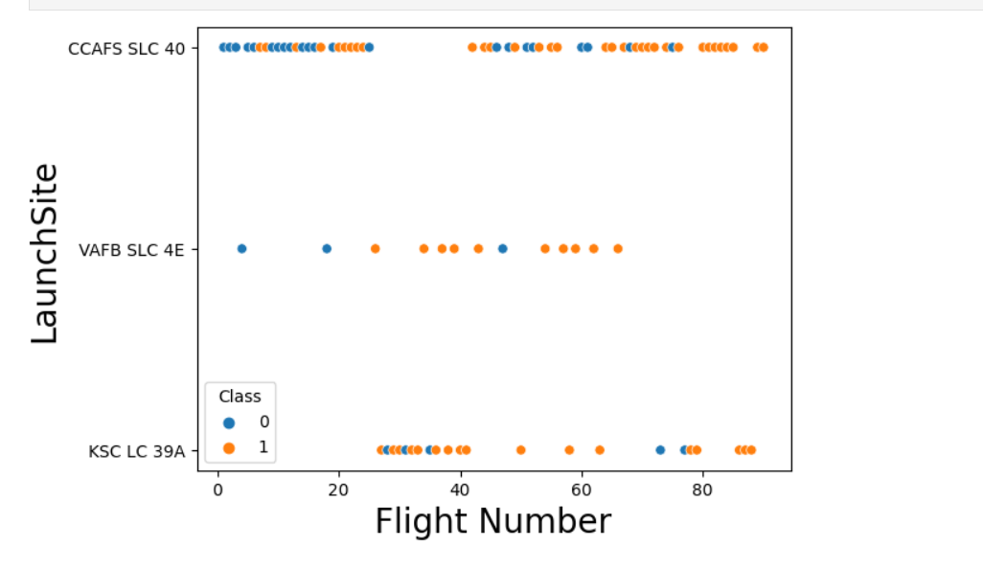
Flight Number vs. Launch Site
With higher flight numbers i.e, greater than 40 the success rate for the Rocket is increasing

Slide 19
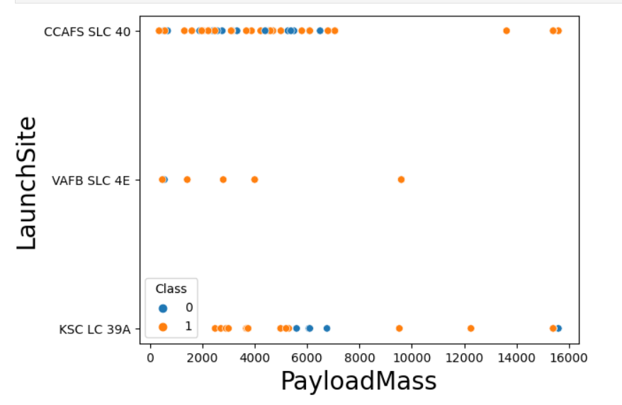
Payload vs. Launch Site
The greater the payload mass(greater than 7000 kg) higher the success rate for the Rocket. But there’s no clear pattern to take a decision, if the launch site is dependent on pay load mass for a success launch

Slide 20
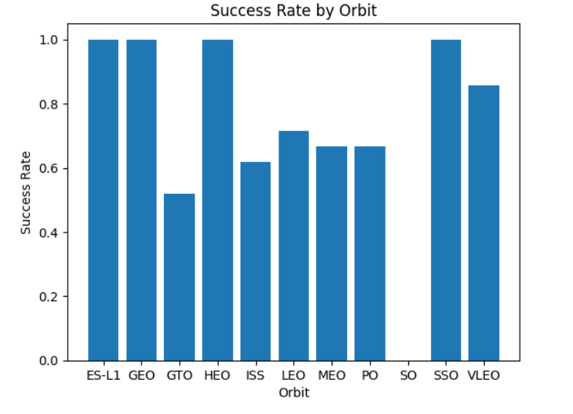
Success Rate vs. Orbit Type
ES-L1,GEO,HEO,SSO has highest success rates

Slide 21
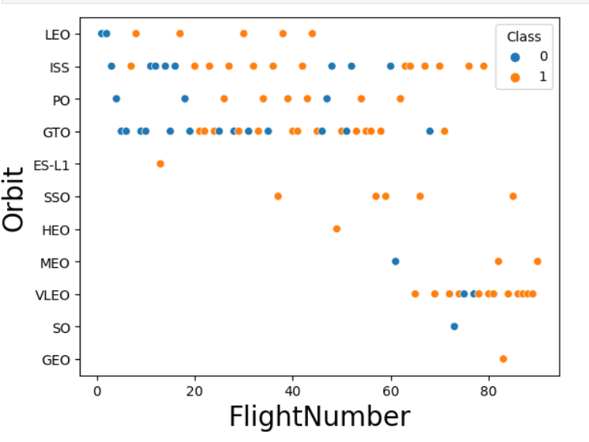
Flight Number vs. Orbit Type
We see that for LEO orbit the success increases with the number of flights
On the other hand, there seems to be no relationship between flight number and the GTO orbit

Slide 22
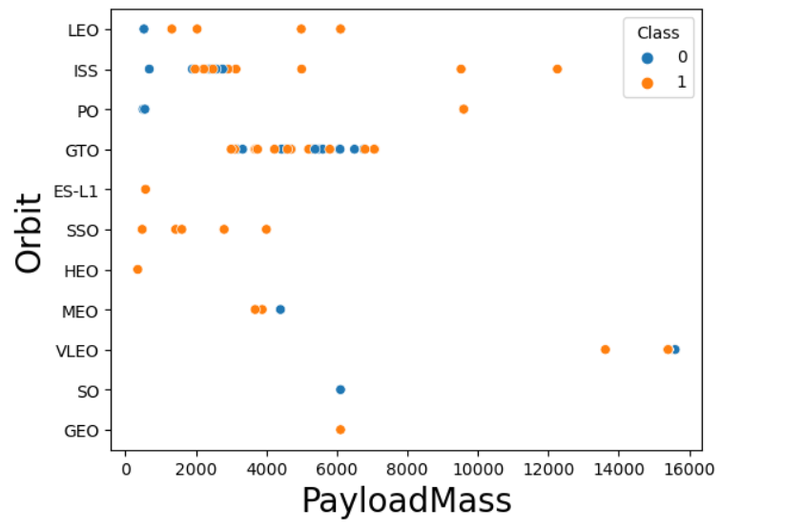
Payload vs. Orbit Type
We observe that heavy payloads have a negative influence on MEO, GTO, VLEO orbits
Positive on LEO,ISS, orbits.

Slide 23
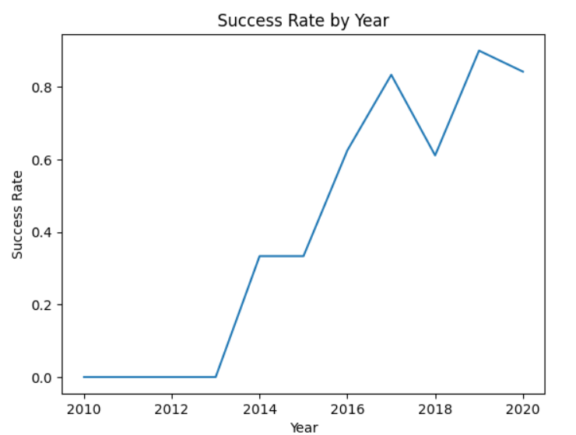
Launch Success Yearly Trend
We can observe that the success rate since 2013 kept increasing relatively though there is slight dip after 2019

Slide 24
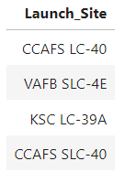
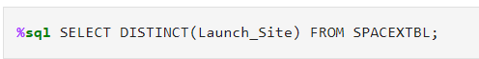
All Launch Site Names
SQL
Description
using the word DISTICT in the query we pull unique values for Launch_Site Column from table SpaceX

Slide 25
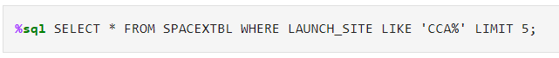
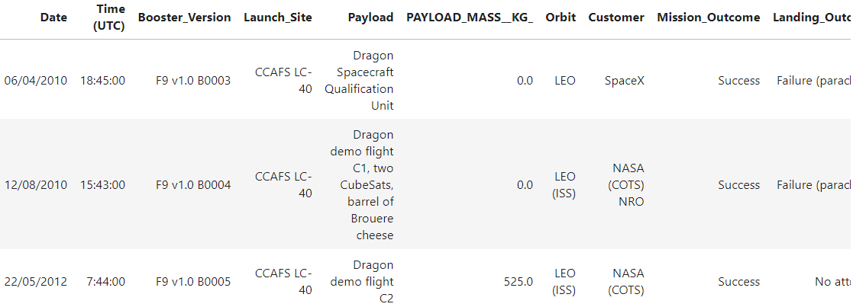
Launch Site Names begin with ‘CCA’
SQL
Description
Using key word ‘LIMIT 5’ in the query we fetch 5 records from table SpaceX and with condition LIKE keyword with wild card –’CCA%’. The percentage in the end suggests that the Launch_Site name must start with CCA

Slide 26
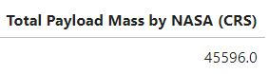
Total Payload Mass
SQL Query
Description
Using the function SUM calculate the total in the total in the column PAYLOAD_MASS_KG and WHERE clause filters the data to fetch Customer’s by name NASA(CRS)

Slide 27
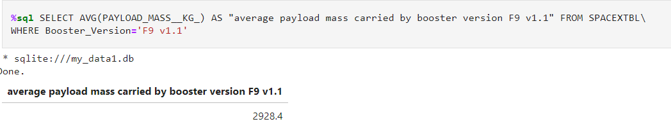
Average Payload Mass by F9 v1.1
Description
using the function AVG works out the average in the column PAYLOAD_MASSS_KG_
The WHERE clause filters the dataset to only perform calculation on Booster_version “F9 v1.1”.

Slide 28
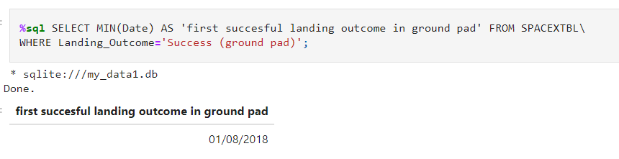
First Successful Ground Landing Date
Description
Using the function MIN works out the minimum date in the column Date and WHERE clause filters the data to only perform calculations on Landing _outcome with values “Success(ground pad)”

Slide 29
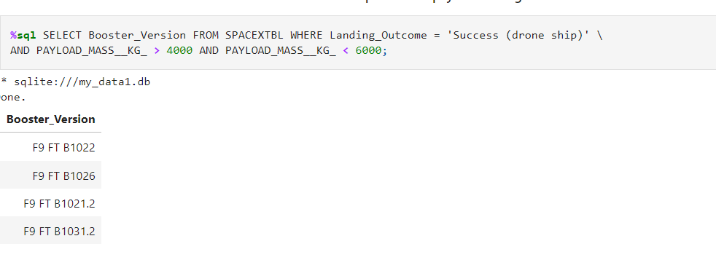
Successful Drone Ship Landing with Payload between 4000 and 6000
Description
Selecting only Booster_Version
WHERE clause filters the dataset to Landing_Outcome=Success(drone ship)
AND clause specifies additional filter conditions
Payload_MASS_KG_ > 4000 AND Payload_MASS_KG_<6000

Slide 30
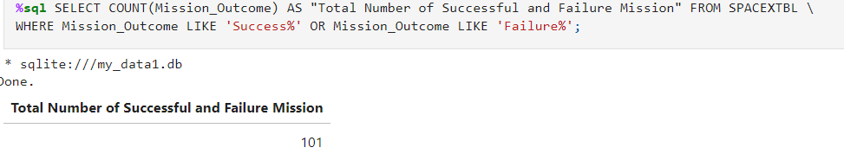
Total Number of Successful and Failure Mission Outcomes
Description
Selecting multiple count is a complex query. I have used case clause within sub query for getting both success and failure counts in same query
Case when MISSION_OUTCOME LIKE ‘%Success%’ then 1 else 0 end returns a Boolean value which we sum to get the result needed

Slide 31
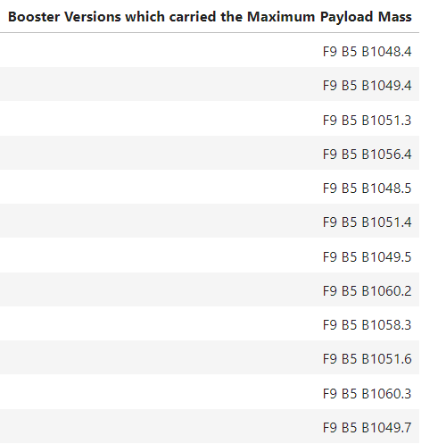
Boosters Carried Maximum Payload
Description
Using the function MAX works out the maximum payload in the column PAYLOAD_MASS_KG_ in sub query.
WHERE clause filters Booster Version which had that maximum payload

Slide 32
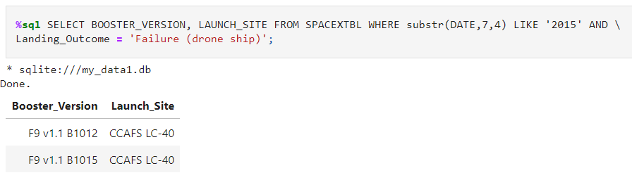
2015 Launch Records
Description
We need to list the records which will display the month names, failure landing_outcomes in drone ship, booster versions, launch_site for the months in year 2015.
Via year function we extract the year and future where clause ‘Failure(drone ship) fetches our required values.

Slide 33
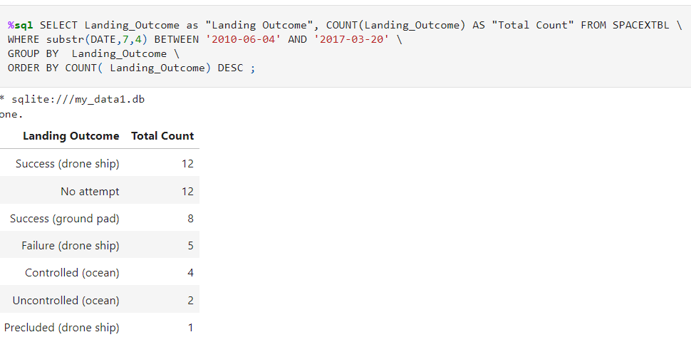
Rank Landing Outcomes Between 2010-06-04 and 2017-03-20
Description
Selecting only LANDING_OUTCOME,
WHERE clause filters the data with DATE BETWEEN ‘2010-06-04’ AND ‘2017-03-20’
Grouping by LANDING_OUTCOME
Order by COUNT(LANDING_OUTCOME) in Descending Order

Slide 34

Section 3

Slide 35
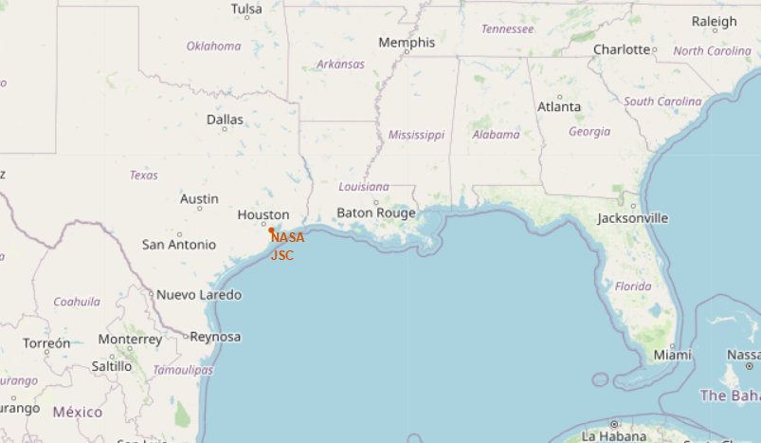
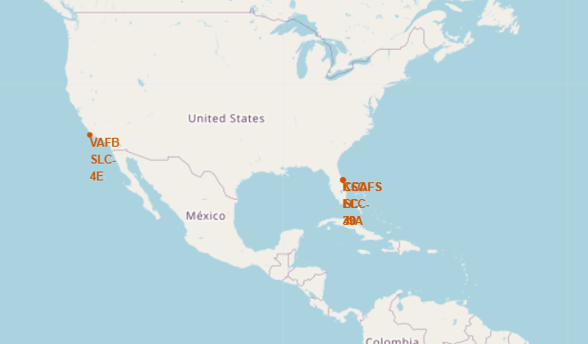
<Folium Map Screenshot 1>

Slide 36
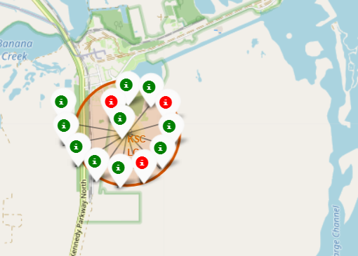
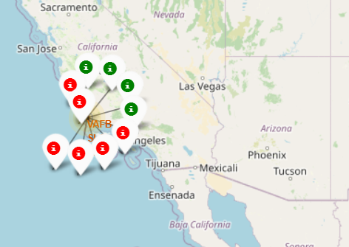
<Folium Map Screenshot 2>
From the color-labeled markers in marker clusters, we should be able to easily identify which launch sites have relatively high success rates

Slide 37
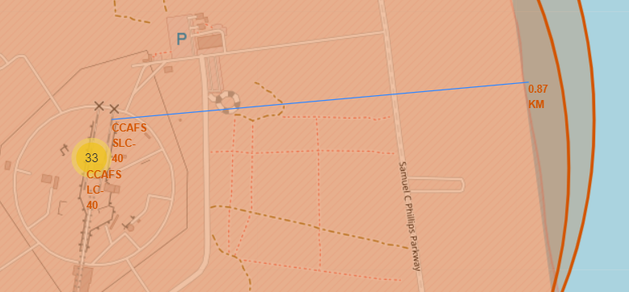
<Folium Map Screenshot 3>
PolyLine between a launch site to the selected coastline point

Slide 38

Section 4

Slide 39
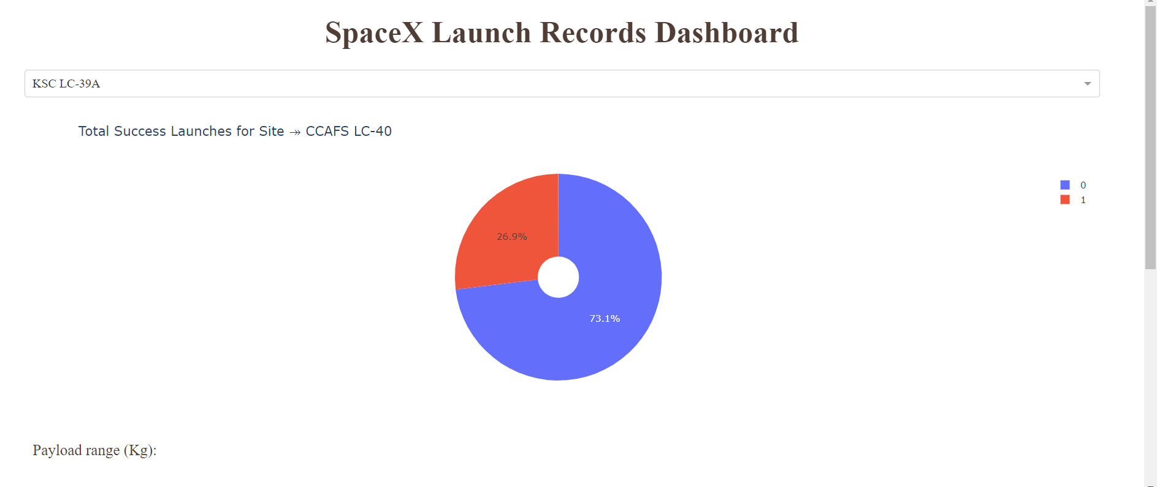
<Dashboard Screenshot 1>
By creating pie chart, we can find which site has the largest successful launches and find the highest launch success rate

Slide 40
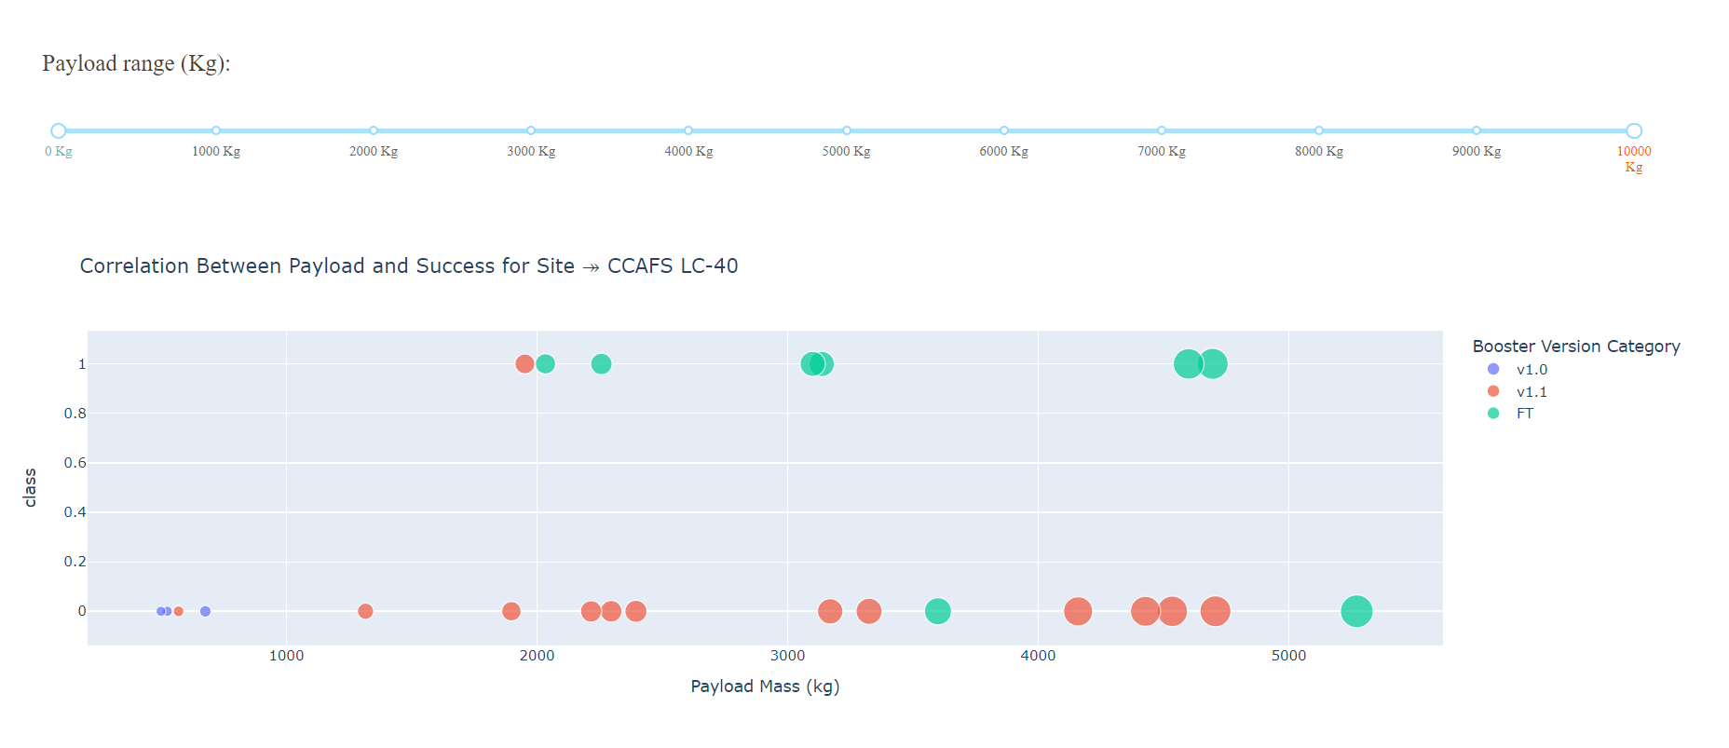
<Dashboard Screenshot 2>
By creating scatter plot which payload has the highest launch success rate and find the which payload ranges has the lowest launch success rate

Slide 41

Section 5

Slide 42
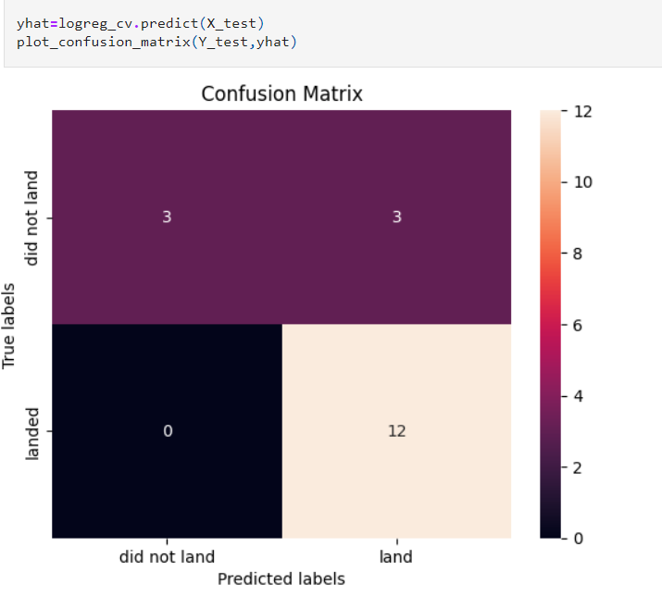
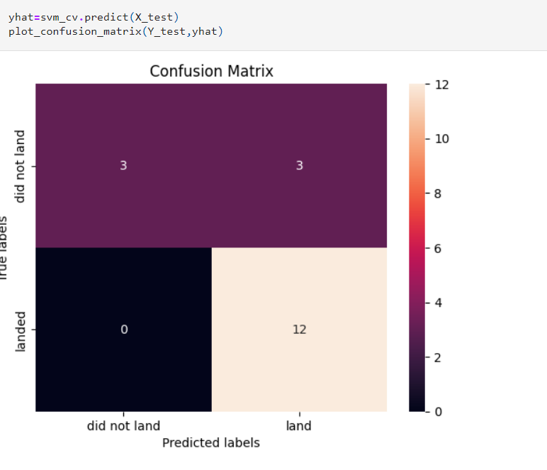
Classification
By using confusion matrix, we can find the True positive, True negative, False positive , False negative

Slide 43
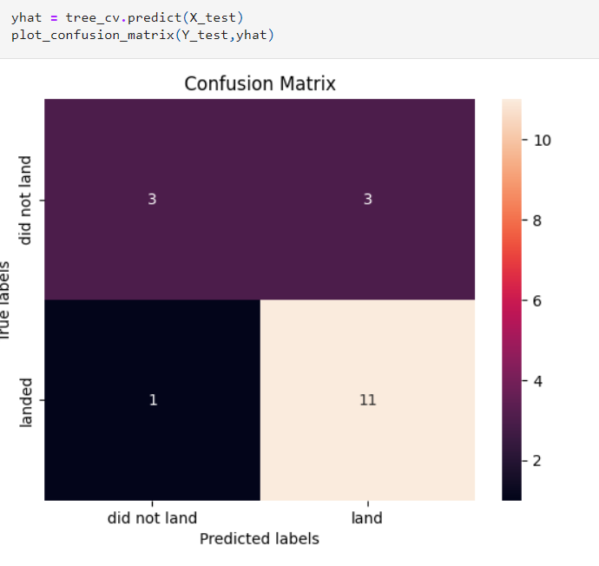
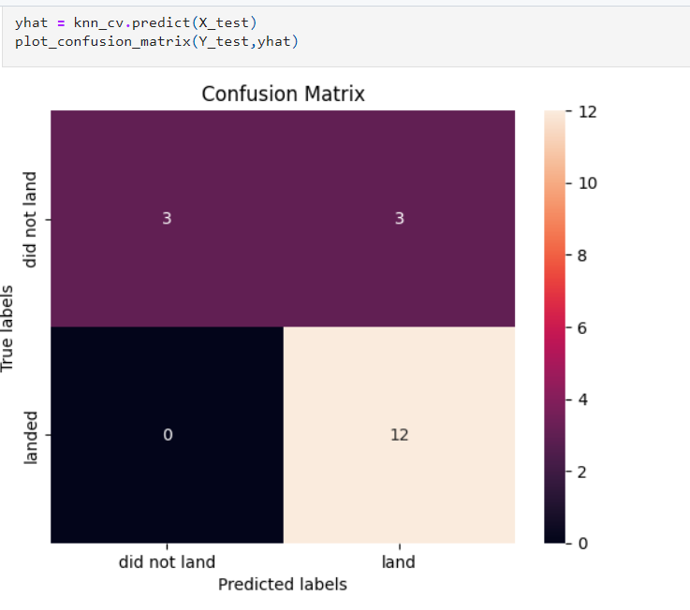
Confusion Matrix

Slide 44
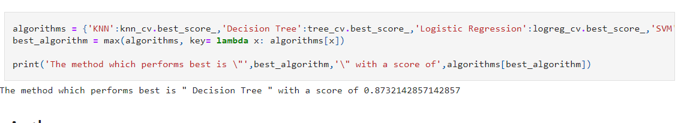
Conclusions
By observing all 4-classification model Decision Tree has more accuracy than other models
Decision tree is best for predicting the SpaceX landing outcome

Slide 45
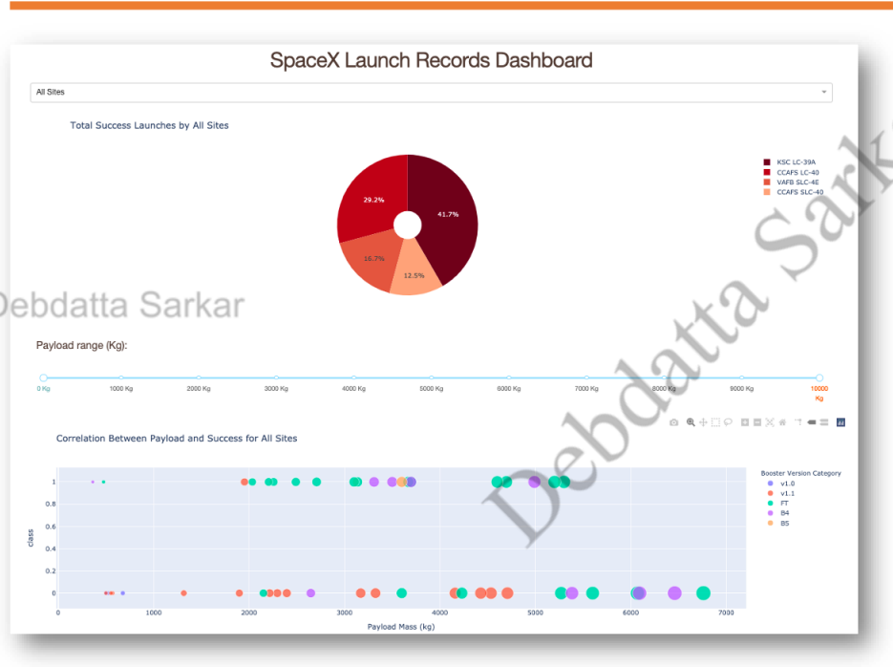
Appendix

Slide 46


